Slide 1
Mitchell and Merritt’s Algorithm for single resource model
Works on the single resource model Belongs to the class of edge-chasing algorithms where probes are sent in opposite direction of the edges of WFG.
Each node has two labels- Private and Public where initially both has same values
Private is unique but might change
Has four nondeteministic state transitions
- Block, Transmit, Detect, Activate
Notes:
https://groups.csail.mit.edu/tds/papers/Merritt/podc84.pdf
No phantom deadlocks as long as process’ dont fail.

Slide 2
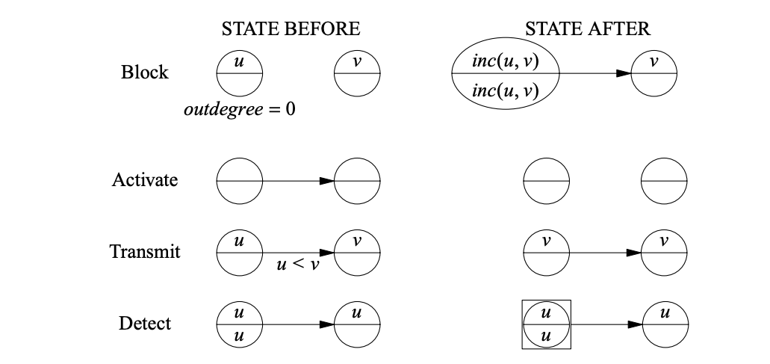

Slide 3
2
3
2
3
4
1
4
1

Slide 4
5=inc(3,2)
3
5=inc(3,2)
3
4
1
4
1

Slide 5
5
3
5
3
4
6=inc(4,1)
4
6=inc(4,1)

Slide 6
5
3
5
3
7=inc(4,5)
6
7=inc(4,5)
6

Slide 7
5
3
5
3
7
7 6
7
6

Slide 8
5
8=inc(3,7)
5
8=inc(3,7)
7
7 6
7
6

Slide 9
8 5
8
5
8
7
7
7
6

Slide 10
8
8
5
8
8 7
7
7
6

Slide 11
8
8
5
8
8
8 7
7
6

Slide 12
8
8
5
8
Deadlock Detected!
8
8
7
6

Slide 13
Easy Questions
Can a node be part of multiple cycles?
Suppose a node has added the last edge of a cycle and hence started a transmit. Can his private and public label change by the time the transmit reaches him back?
Does the start of a transmit imply the presence of a cycle?

Slide 14
Easy Questions Answers
Can a node be part of multiple cycles? No. It’s a single resource model
Suppose a node has added the last edge of a cycle and hence started a transmit. Can his private and public label change by the time the transmit reaches him back? No. requires a block or transmit to make a change. Cant have a second block or transmit as it is a single resource model and part of single cycle at most.
Does the start of a transmit imply the presence of a cycle? No. Consider edge e1 existed between nodes a → b. Edge e1 is now incident on a new block due indicated by e2 between b→c. The new updated value of node b might cause a transmit to a (no cycle present).

Slide 15
More Questions
In case of a cycle, the process to detect the deadlock with have the highest public id in the cycle. T/F?
H.W Can there be Phantom Deadlocks

Slide 16
More Questions Answers
In case of a cycle, the process to detect the deadlock with have the highest public id in the cycle. T/F? True

Slide 17
Priority based algorithm
Currently some random process in the cycle being the one to abort
Would be preferred that a lowest priority process aborts itself. Initial values: Upper and bottom values are tuple. Each tuple (x,y) has unique public label and unique priority number of node to start. Priority number is always unique.

Slide 18
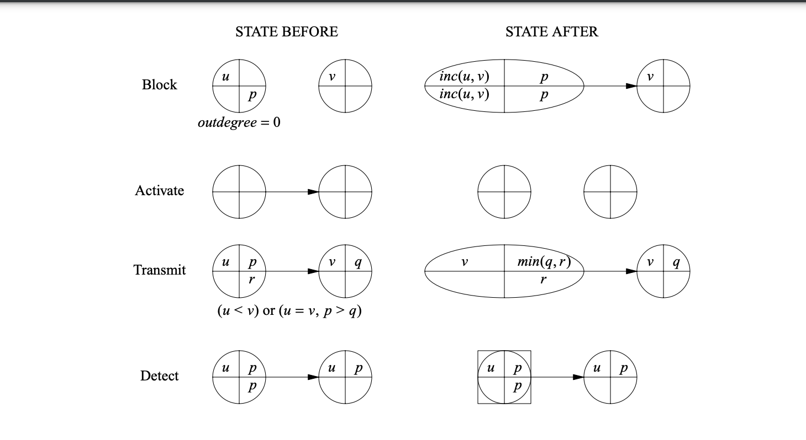
With priority
https://www.researchgate.net/publication/221343313_A_Distributed_Algorithm_for_Deadlock_Detection_and_Resolution

Slide 19
2 2
3 3
2 2
3 3
4 4
1 1
4 4
1 1

Slide 20
5 2
3 3
5 2
3 3
4 4
1 1
4 4
1 1

Slide 21
5 2
3 3
5 2
3 3
4 4
1 1
4 4
1 1

Slide 22
5 2
3 3
5 2
3 3
4 4
6 1
4 4
6 1

Slide 23
5 2
3 3
5 2
3 3
4 4
6 1
4 4
6 1

Slide 24
5 2
3 3
5 2
3 3
7 4
6 1
7 4
6 1

Slide 25
5 2
3 3
5 2
3 3
7 4
6 1
7 4
6 1

Slide 26
5 2
8 3
5 2
8 3
7 4
6 1
7 4
6 1

Slide 27
5 2
8 3
5 2
8 3
7 4
6 1
7 4
6 1

Slide 28
8 2
8 3
5 2
8 3
7 4
6 1
7 4
6 1

Slide 29
8 2
8 3
5 2
8 3
8 2
6 1
7 4
6 1

Slide 30
8 2
8 3
5 2
8 3
8 2
8 1
7 4
6 1

Slide 31
8 2
8 1
5 2
8 3
8 2
8 1
7 4
6 1

Slide 32
8 1
8 1
5 2
8 3
8 2
8 1
7 4
6 1

Slide 33
8 1
8 1
5 2
8 3
8 1
8 1
7 4
6 1

Slide 34
8 1
8 1
5 2
8 3
8 1
8 1
7 4
6 1
Deadlock detected!!

